Slide 1

Fine-tuning
Dr Maria Prokofieva

Slide 2

What we will cover
What is fine-tuning
How it works
How to apply

Slide 3
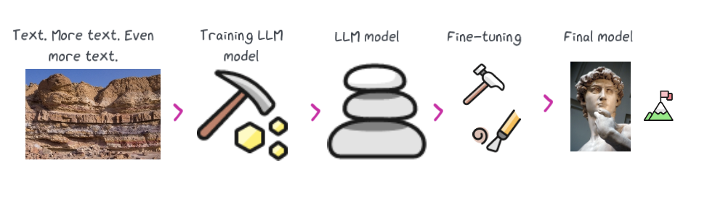
Fine-Tuning
adapting a pre-trained model to a specific task by further training it on a task-specific dataset.

Slide 4
Why Fine-Tuning
Leverage pre-trained knowledge:
Adapts a general-purpose pre-trained model to specific tasks, enhancing performance.
Improved task performance:
Tailors the model to understand the nuances of your specific dataset and task.
Efficiency:
Requires less data and computational resources compared to training a model from scratch.
Wide application:
Applicable to various tasks like text classification, sentiment analysis, and more, enabling models to excel in specialized scenarios.
Notes:
Why Fine-Tuning is Important
Leverage Pre-Trained Knowledge:
Large models are pre-trained on extensive datasets that cover a wide range of topics and language patterns. This pre-training allows the model to learn general features of language, such as syntax, semantics, and general knowledge.
Fine-tuning enables the model to apply this general knowledge to specific tasks, improving performance without requiring a massive amount of task-specific data.
Improved Task Performance:
By fine-tuning on a specific dataset, the model can learn the nuances and intricacies of the task, resulting in better performance compared to using the pre-trained model directly.
For example, a model pre-trained on a general text corpus can be fine-tuned on a sentiment analysis dataset to improve its ability to classify text as positive or negative.
Efficiency:
Fine-tuning is much more computationally efficient than training a model from scratch. Since the model already has a solid foundation from pre-training, fine-tuning only requires a fraction of the data and computational resources.

Slide 5
How fine-tuning works
Start with a pre-trained model:
1
Use a model that has already been trained on a large, general dataset.
Prepare a task-specific dataset:
2
Collect and label data relevant to the specific task
Adjust the model:
3
Training on the task-specific dataset, with a smaller learning rate to retain pre-trained knowledge.
Evaluate performance:
4
Test on a validation set to ensure it performs well on the specific task.
Notes:
How Fine-Tuning Works
Pre-Trained Model:
Start with a pre-trained model, which has already been trained on a large corpus. This model serves as the base for fine-tuning.
Task-Specific Dataset:
Obtain a dataset specific to the task you want the model to perform. This dataset should be labeled and relevant to the task, such as labeled examples for text classification, question answering, or text summarization.
Adjusting the Model:
During fine-tuning, the model's weights are adjusted based on the new, task-specific data. This typically involves updating the final layers of the model to better align with the task's objectives.
Training:
The model is trained on the task-specific dataset, usually with a smaller learning rate than what would be used for training from scratch. This ensures that the model retains the general knowledge it learned during pre-training while adapting to the specific task.
Depending on the size of the task-specific dataset and the complexity of the task, fine-tuning may involve several epochs of training.
Evaluation:
After fine-tuning, the model is evaluated on a validation set to ensure it has learned the task effectively and is not overfitting to the fine-tuning data.

Slide 6
Key Points in Fine-Tuning
Learning rate:
Use a smaller learning rate to retain pre-trained knowledge while adapting to the new task.
Batch size:
Adjust based on computational resources; larger batches speed up training but require more memory.
Overfitting:
Mitigate with regularization techniques like dropout and weight decay.
Task-specific layers:
Focus on fine-tuning the final layers to preserve general features learned during pre-training.
Notes:
Learning Rate:
Fine-tuning usually requires a smaller learning rate compared to training from scratch. This is because the model already has a well-formed set of weights from pre-training.
Batch Size:
The batch size may vary depending on the available computational resources and the size of the dataset. Larger batch sizes can speed up training, but they require more memory.
Overfitting:
Since the fine-tuning dataset is typically much smaller than the pre-training dataset, there is a risk of overfitting. Regularization techniques, such as dropout and weight decay, can help mitigate this.
Task-Specific Layers:
Often, only the final layers of the model are fine-tuned, while the earlier layers (which capture more general features) are left relatively unchanged. This approach helps retain the general knowledge acquired during pre-training.

Slide 7
Using Trainer for fine-tuning at HF
abstracts much of the boilerplate code involved in training, making it easier to fine-tune models with minimal setup.
Trainer API

Slide 8
Steps for fine-tuning with Trainer
Load model and tokenizer:
01
Prepare the dataset:
02
Load and tokenize your task-specific dataset.
Set training arguments:
03
Define parameters
Initialize Trainer:
04
Pass the model, training arguments, and datasets to the Trainer.
Train the model:
05
Execute the fine-tuning process using the train method.
Evaluate and save:
06
Assess performance and save the fine-tuned model.
Start with a pre-trained model and its tokenizer.

